Slide 1



LILaC: Late Interacting in Layered Component Graph for Open-domain Multimodal Multihop Retrieval
Joohyung Yun, Doyup Lee, and Wook-Shin Han*

Slide 2
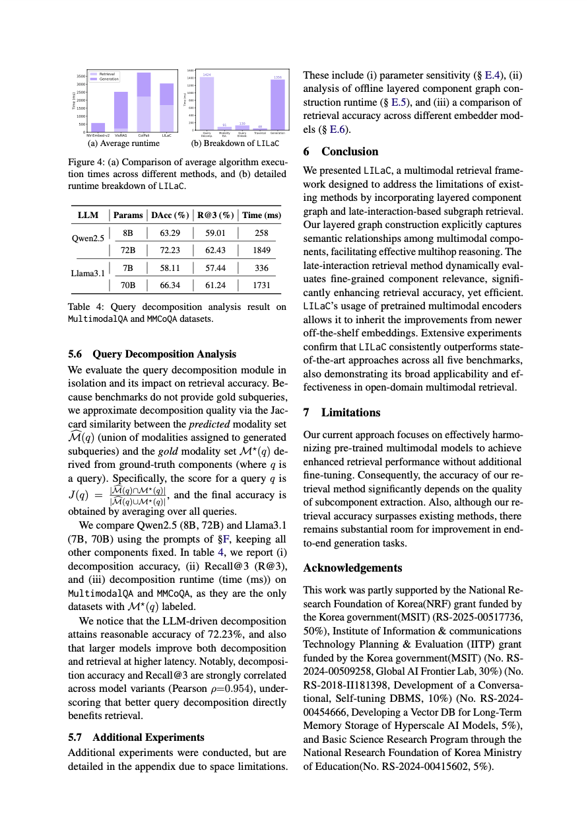
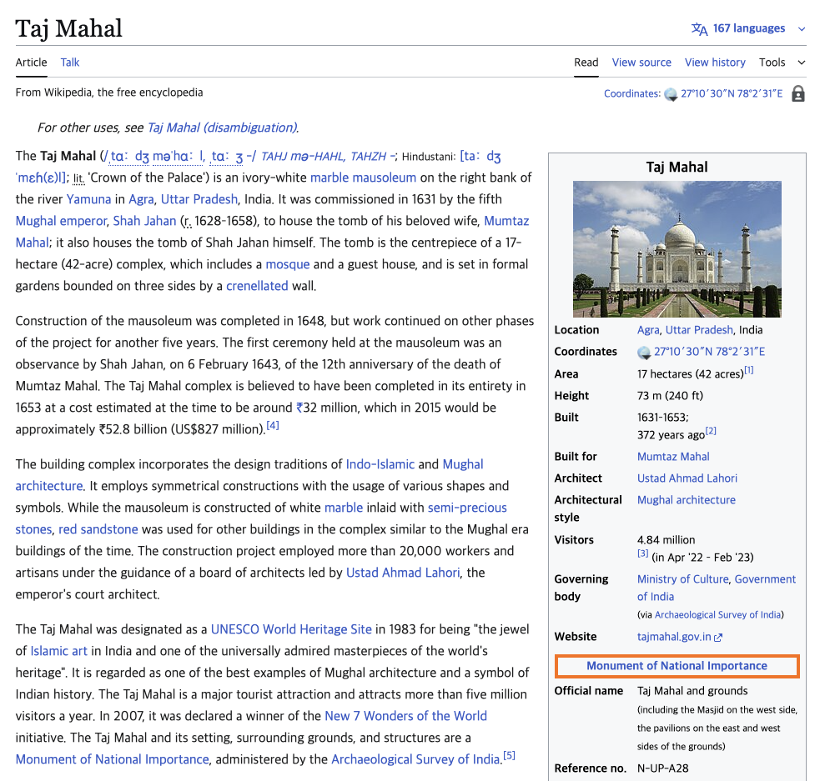
Multimodal Documents Are Everywhere!
Real-world documents are often multimodal.
e.g., webpages, PDFs, presentation slides, and way more!
Accurate question-answering involves correctly resolving the relationships between the components.
Component: a multimodal element (i.e., text/table/image) which comprises a document.
An example webpage
An example PDF file

Slide 3



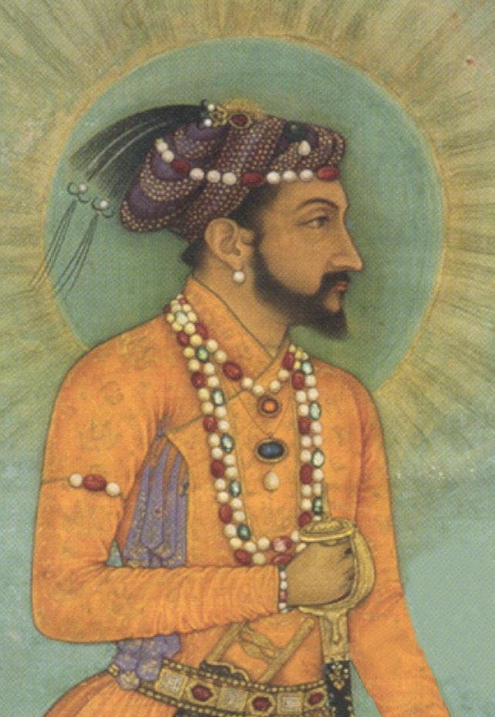
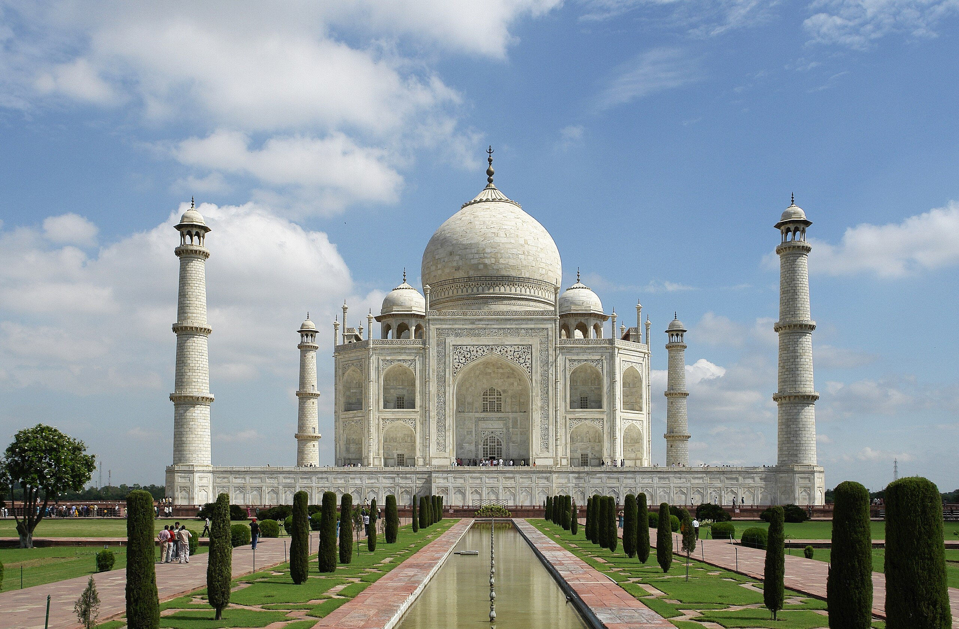
Multimodal Document Question Answering
Correctly answering the given question using information of multimodal components
In the mausoleum built by the Mughal emperor who married Mumtaz Mahal, how many slender minarets surround the central dome?
Four
Shah Jahan
Taj Mahal
Shah Jahan commissioned many monuments, including the Red For and the Taj Mahal, where his favorite consort Mumtaz Mahal is entombed.
The Taj Mahal is an ivory white marble mausoleum on the right bank of the river Yamuna in Agra, India.
Multimodal
Documents

Slide 4

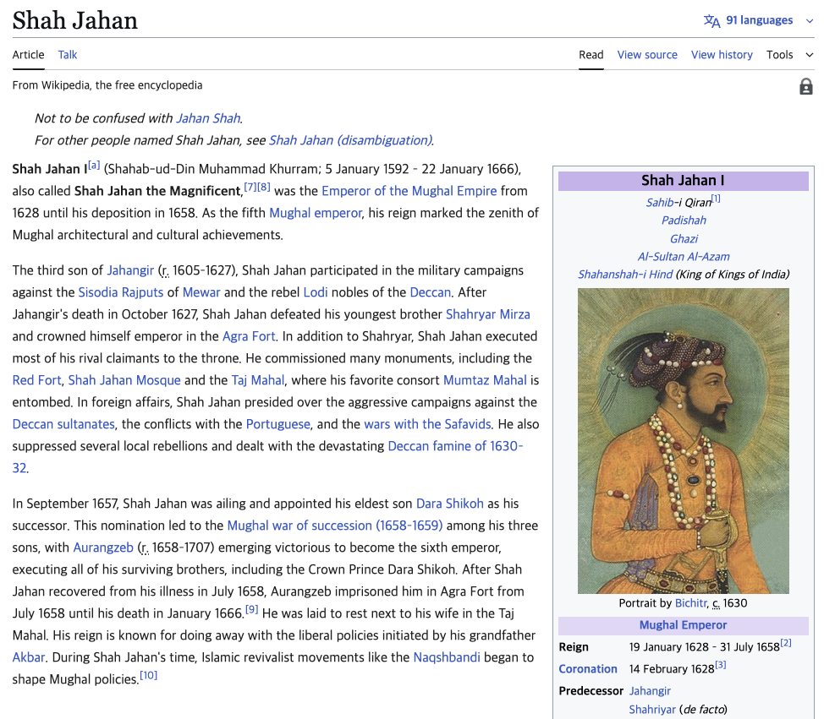
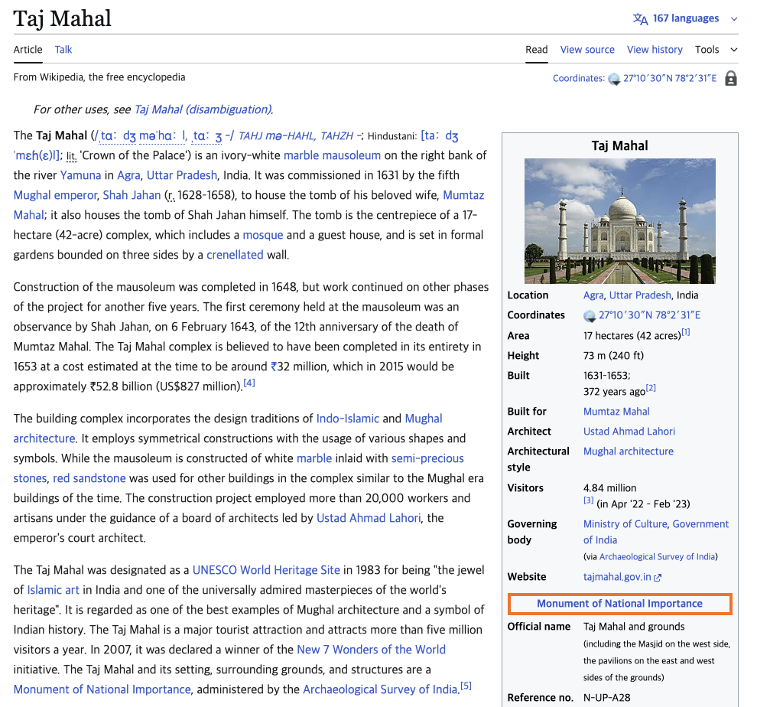



How Can We Model Multimodal Documents?
Component: One of paragraph, table or an image
Document: A set of components
Document
Document
Paragraphs
Paragraphs
Images
Images
Hyperlink
Tables
Tables

Slide 5

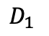
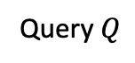
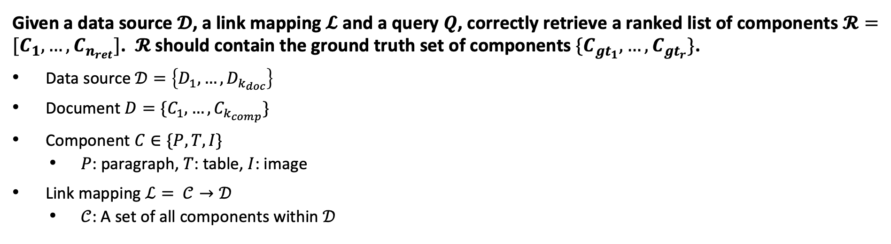
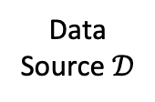
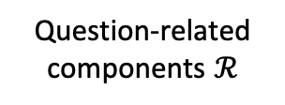
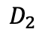
Our Task Open-Domain Multimodal Document Retrieval
Given a data source $𝓓$, a link mapping $𝓛$ and a query $Q$, correctly retrieve a ranked list of components $𝓡=[C_{1},…, C_{n_{ret}}]$. $𝓡$ should contain the ground truth set of components $\{C_{gt_{1}},…, C_{gt_{r}}\}$.
Data source $𝒟=\left\{D_{1}, …, D_{k_{doc}}\right\}$
Document $D=\{C_{1},…,C_{k_{comp}}\}$
Component $C∈\{P, T, I\}$
$P$: paragraph, $T$: table, $I$: image
Link mapping $ℒ= 𝒞→𝒟$
$𝒞$: A set of all components within $𝒟$
Query $Q$
Data
Source $𝒟$
$$D_{1}$$
Retriever
Question-related components $ℛ$
$$D_{2}$$

Slide 6



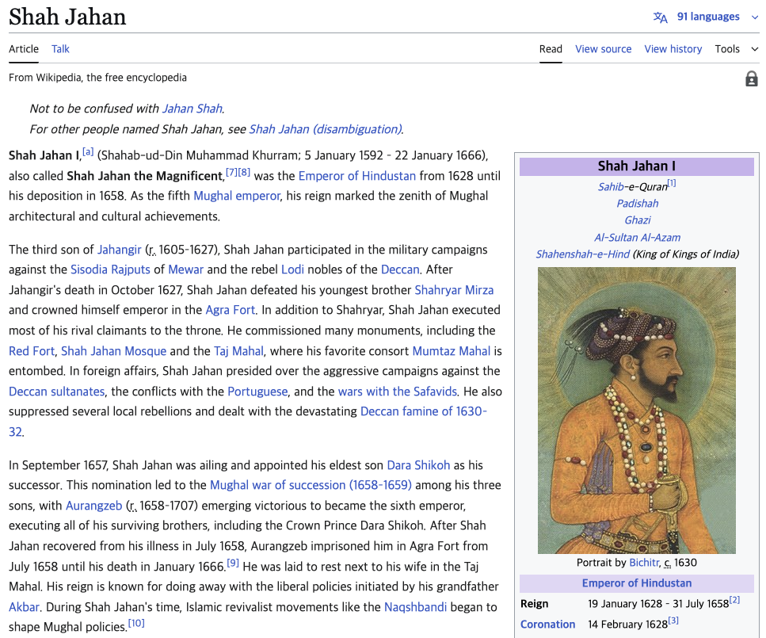
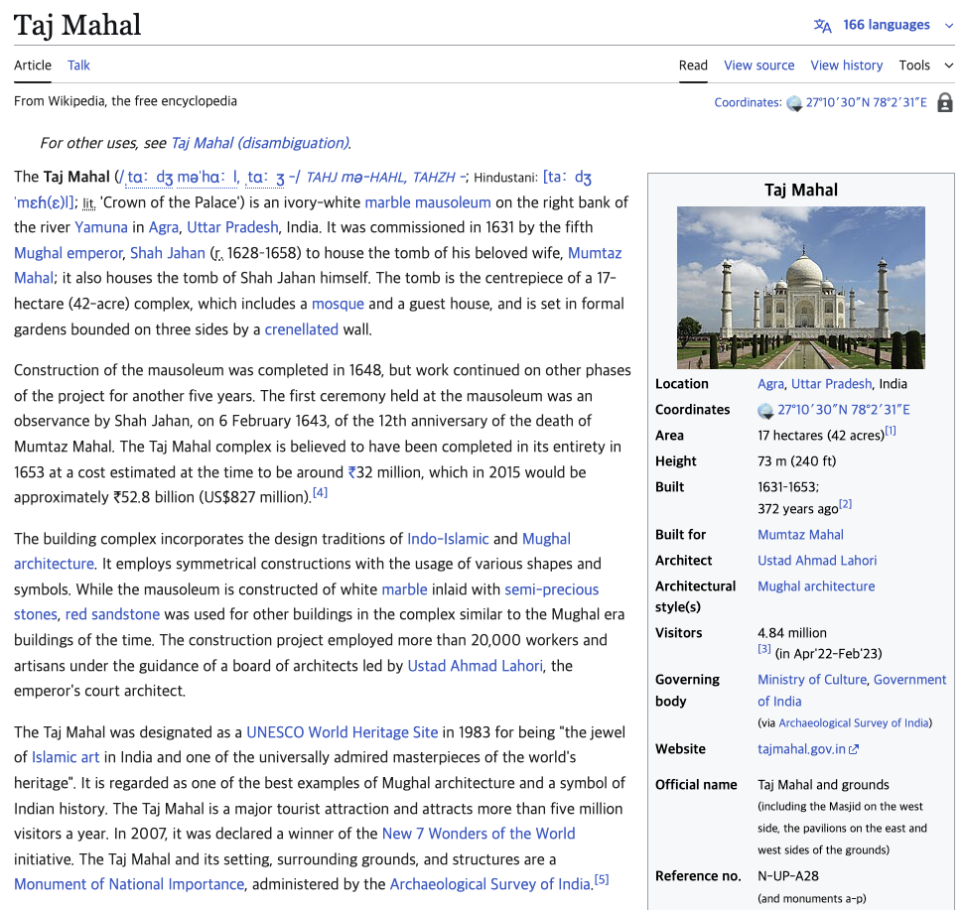
Problems of Existing Work
In the mausoleum built by the Mughal emperor who married Mumtaz Mahal, how many slender minarets surround the central dome?
Four
Shah Jahan
Taj Mahal
Multimodal
Documents
Shah Jahan commissioned many monuments, including the Red For and the Taj Mahal, where his favorite consort Mumtaz Mahal is entombed.
The Taj Mahal is an ivory white marble mausoleum on the right bank of the river Yamuna in Agra, India.
Shah Jahan commissioned many monuments, including the Red Fort, Shah Jahan Mosque and the Taj Mahal, where his favorite consort Mumtaz Mahal is entombed.
The picture captures a classic, head-on view of the Taj Mahal in Agra, India. The ivory-white marble mausoleum dominates the scene with its large central onion dome.
Minarets? Not a word about them!
TextRAG
Lossy
Summarization
TextRAG Retriever
I see Shah Jahan… but no trail to follow!
Everything's crammed into one screenshot!
VisRAG
Loss of
Hyperlinks
VisRAG Retriever

Slide 7
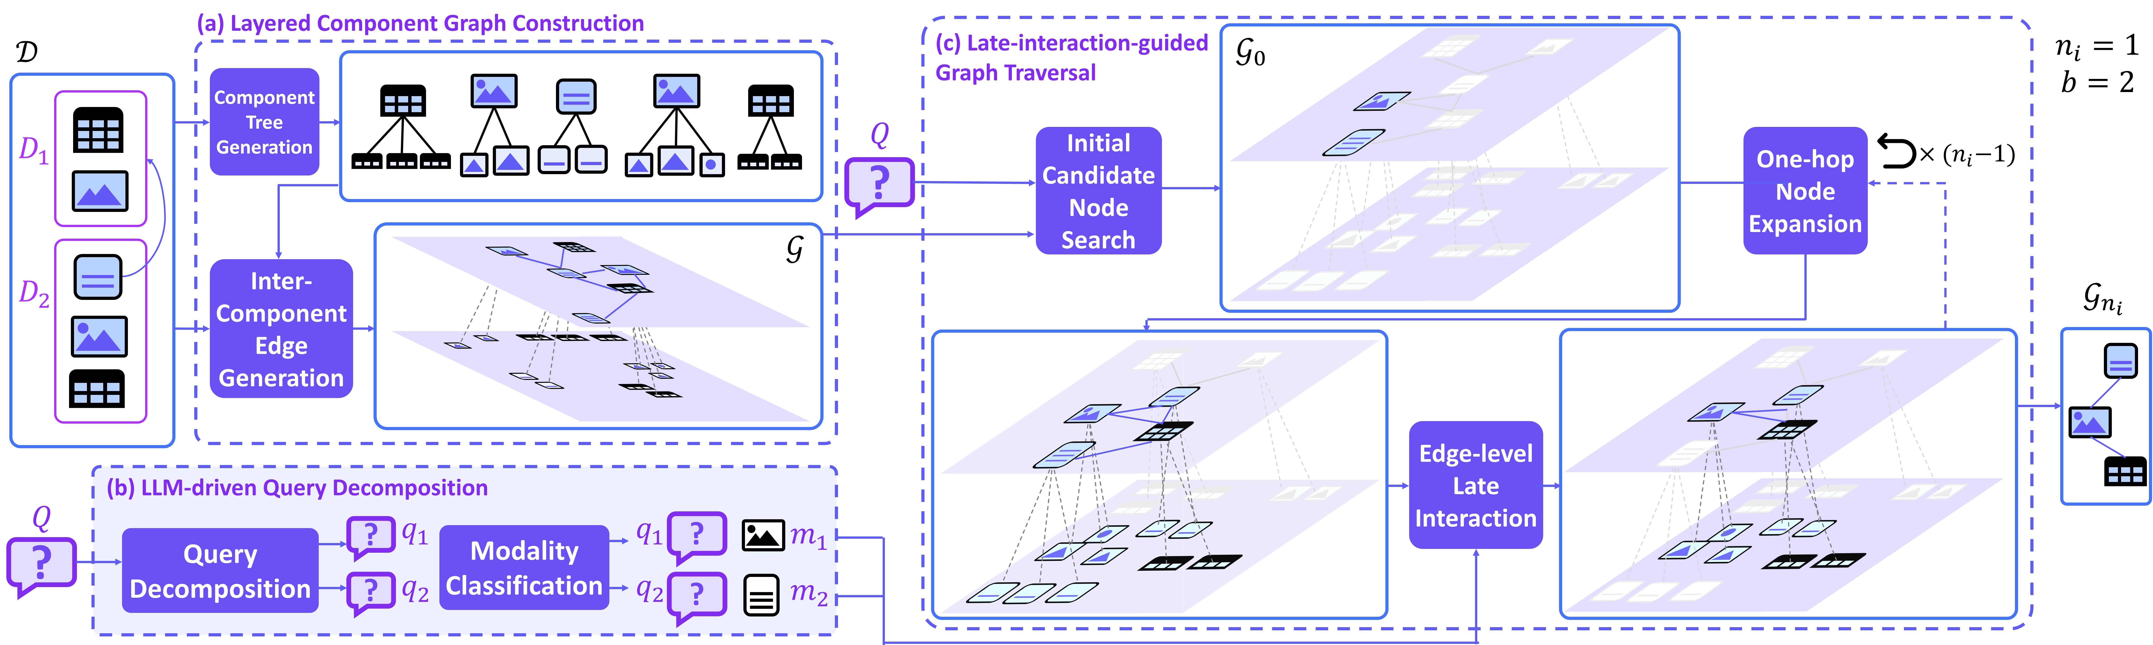
Overview of LILaC
Offline: generate a graph data structure
Online: retrieve a query-relevant subgraph from the graph

Slide 8
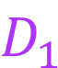
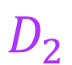
What Should We Consider for the Graph?
Modality preservation
Multimodal multihop reasoning: Exploit both inter-document links and intra-document relationships
Consideration of fine-grained granularity [1]: Paragraph -> sentences, Table -> rows, Image -> detected objects
$$D_{1}$$
$$D_{2}$$
[1] Chen, Tong, et al. "Dense x retrieval: What retrieval granularity should we use?." EMNLP (2024).

Slide 9
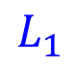
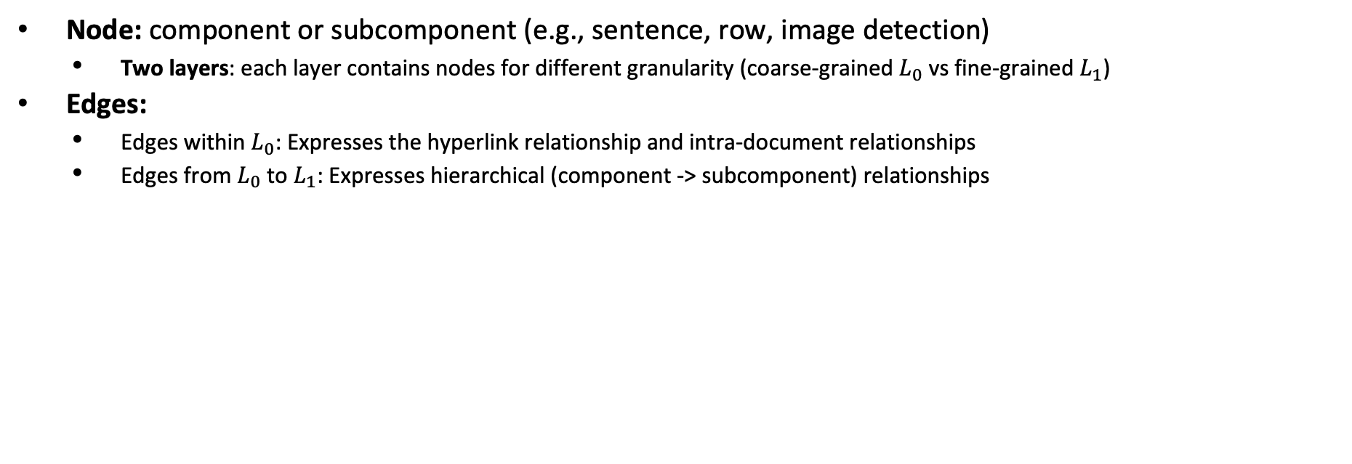
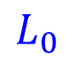
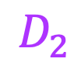
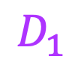
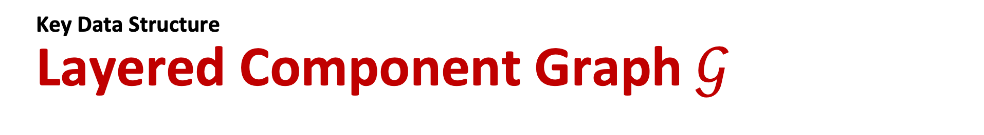
Key Data Structure Layered Component Graph $𝒢$
Node: component or subcomponent (e.g., sentence, row, image detection)
Two layers: each layer contains nodes for different granularity (coarse-grained $L_{0}$ vs fine-grained $L_{1}$)
Edges:
Edges within $L_{0}$: Expresses the hyperlink relationship and intra-document relationships
Edges from $L_{0}$ to $L_{1}$: Expresses hierarchical (component -> subcomponent) relationships
$$D_{1}$$
$$D_{2}$$
$$L_{0}$$
$$L_{1}$$

Slide 10
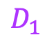
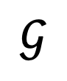
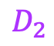
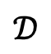
Layered Component Graph Construction
$$𝒟$$
Component Tree Generation
Break down components into subcomponents · Passage -> Split into sentences · Table -> Split into rows · Image -> Detect subimages
Connect each component with its subcomponents.
Inter-Component Edge Generation
Generate an undirected edge for
Every pair of components within the same document.
Every pair of component with its linked document’s components.
Embedding Generation
(a) Layered Component Graph Construction
Component Tree Generation
$$D_{1}$$
$$𝒢$$
$$D_{2}$$
Inter-Component
Edge
Generation
: embedding vector

Slide 11
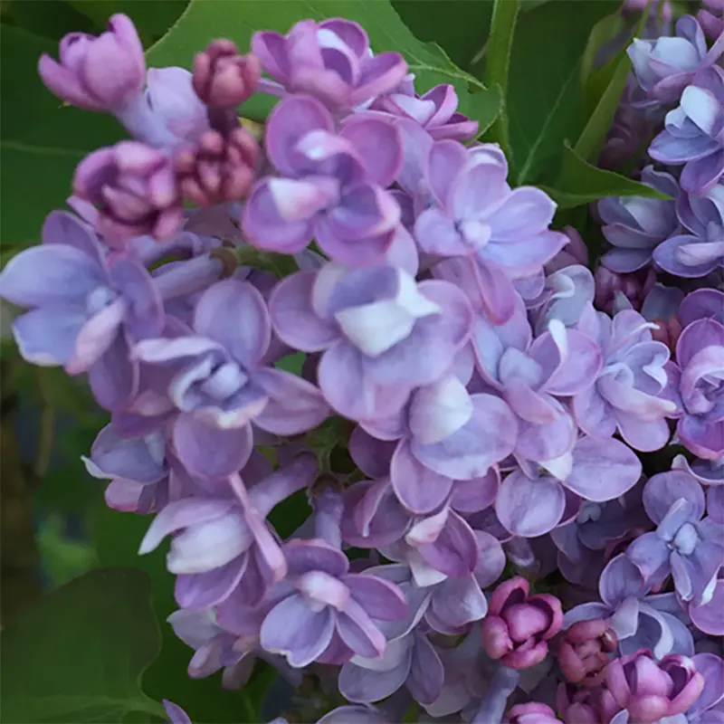

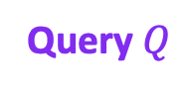
Background Multimodal Embedders
They embed a natural language sequence, an image, or a combination of two into a single vector.
They require an instruction for each retrieval.
Instruction includes information about the target modality of the retrieval.
Instruction
LILaC
Query $Q$
Retrieve an image relevant to the given text

Slide 12

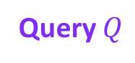

What Should We Consider for the Retrieval Algorithm?
How should we find the instructions for multimodal embedding?
Challenge 1: The instructions are not given in our setting
How should we find subgraphs that need multimodal multihop reasoning?
Challenge 2: The target subgraph may consist of multiple multimodal nodes (multihop reasoning)
Query $Q$
?
$$L_{0}$$
$$L_{1}$$

Slide 13
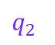
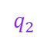
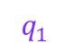
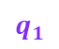
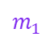
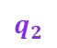
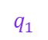
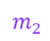
Key Idea LILaC Retrieval Algorithm
Query decomposition & modality estimation: extract subqueries, then perform modality estimation for each subquery.
Edge-based subgraph retrieval: retrieves query-relevant edges, then merges them into a subgraph
Subqueries
$$q_{1}$$
$$q_{2}$$
$$q_{1}$$
$$m_{1}$$
$$q_{1}$$
$$q_{2}$$
$$q_{2}$$
$$m_{2}$$
Query $Q$
?
Query Decomposition
?
?
Modality Estimation
?
?
score calculation?
$$L_{0}$$
$$L_{1}$$

Slide 14
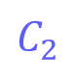
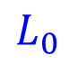
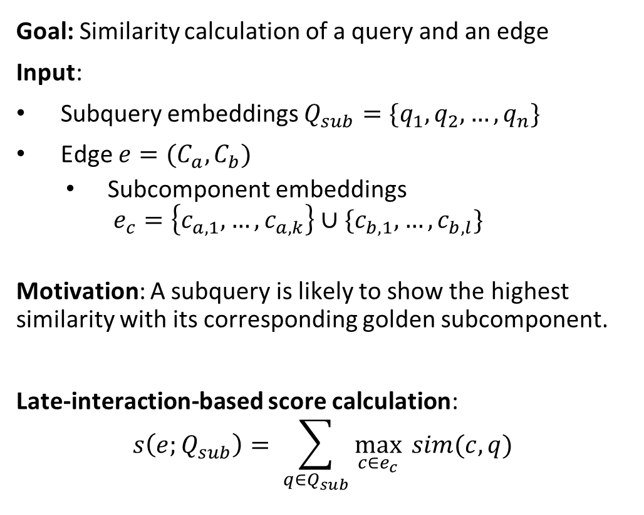
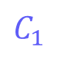
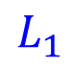
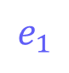
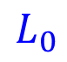
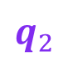
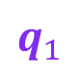

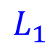
Edge-level Late Interaction
$$C_{1}$$
$$C_{2}$$
$$e_{1}$$
Goal: Similarity calculation of a query and an edge
Input:
Subquery embeddings $Q_{sub}=\{q_{1},q_{2},…,q_{n}\}$
Edge $e=(C_{a}, C_{b})$
Subcomponent embeddings $e_{c}=\left\{c_{a,1},…,c_{a,k}\right\}∪\{c_{b,1},…,c_{b,l}\}$
Motivation: A subquery is likely to show the highest similarity with its corresponding golden subcomponent.
Late-interaction-based score calculation:
$$s\left(e;Q_{sub}\right)= \sum_{q∈Q_{sub}}{\max_{c∈e_{c}}{ sim(c, q)}}$$
$$L_{0}$$
$$L_{1}$$
?
$$q_{1}$$
0.2 | 0.3 | 0.8 | 0.7 | 0.3
?
$$q_{2}$$
0.7 | 0.6 | 0.2 | 0.3 | 0.1
$$s\left(e_{1};Q_{sub}\right)=1.5$$
$$L_{0}$$
$$L_{1}$$

Slide 15
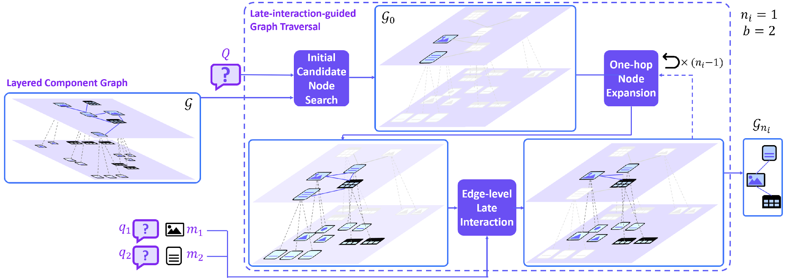
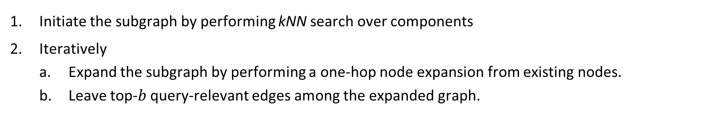
Late-Interaction-Guided Graph Traversal
Initiate the subgraph by performing kNN search over components
Iteratively
Expand the subgraph by performing a one-hop node expansion from existing nodes.
Leave top-$b$ query-relevant edges among the expanded graph.

Slide 16
Overview of LILaC (Revisited)
Offline: generate a graph data structure
Online: retrieve a query-relevant subgraph from the graph

Slide 17

Retriever Accuracy Comparison
LILaC achieves SOTA performance on all 5 benchmarks.
LILaC outperforms the previous VisRAG SOTA models, VisRAG-Ret and ColPali, by substantial margins of 12.39% and 9.85% in R@3, and 14.45% and 10.49% in MRR@10, on average, respectively.

Slide 18

End-to-End QA Accuracy Comparison
More interesting experiments in our paper!
LILaC achieves SOTA average end-to-end accuracy, with average EM and F1 scores of 52.00 and 58.79, respectively.
17.40% and 18.47% accuracy raise compared to the previously best-performing VisRAG with Qwen2.5-VL

Slide 19
Thank You

Slide 23

LLM-Driven Query Decomposition
A single query may include multiple evidences needed to locate multiple components. Such components may differ in their modalities.
Idea:
Decompose the given query so that each subquery contains fine-grained evidence for the target of retrieval.
Estimate (i.e., classify) the target modality for each subquery, and use it to generate an instruction for each subquery embedding.
Retrieval Algorithm
Fine-grained interaction with the graph and the query
Query decomposition
Late interaction

Slide 24
Experiment Settings
Benchmarks:
DocVQA Benchmarks
InfoVQA
MP-DocVQA
SlideVQA
Multimodal QA Benchmarks
MultimodalQA
MMCoQA
Competitors
VisRAG (ICLR’25)
M3DocRAG (ArXiv’24)
Measurements
Component retrieval accuracy
Recall@3
MRR@10
End-to-end accuracy
Exact match (EM)
F1 score

Slide 25




Introduction Multimodal (Text & Image) Data Source
Most of real-world data are comprised of text and images.
Images can play an irreplaceable role in answering some questions.
e.g., “Recommend me a white baby bike”
However, most of prior works do not consider images in neither retrieval nor reading process.
A example Wikipedia page
An example Amazon page
An example Reddit page

Slide 26

Traditional Approaches: TextRAG and VisRAG

Slide 27

Ablation Study
Employing the layered graph structure leads to notable average improvements - 7.33% in R@3 and 10.13% in MRR@10.
Further employing query decomposition & late interaction shows incremental gains of 3.19% in R@3 and 4.7% in MRR@10.

Slide 28

Algorithm Runtime Analysis
LILaC is approximately 20.76% slower than VisRAG, yet 18.24% faster than ColPali.
Late-interaction-based subgraph retrieval step accounts for only about 48 ms (approximately 1.5% of the total runtime).
The major performance bottleneck lies in the query de- composition phase, averaging 1,423 ms.

Slide 29
Next Research
Possible research directions
Problem generalization
Expand the problem beyond Wikipedia setting
Multimodal retrieval improvement
Advanced graph construction
LLM-guided retrieval
Multimodal generation improvement
Current theoretical problems of LILaC
Cannot retrieve components for which dependency resolution is needed.
Ineffective to retrieve long-hop evidences.
-> Currently performing a fine-grained error analysis.

Slide 30






Layered Component Graph Construction
Component Tree Generation
Inter-Component
Edge
Generation

